Slide 1
Interim Results
Master Thesis: Sex Differences in Acute Neglect

Slide 2
Lesion Overlap Plots
Created with MRIcron

Slide 3
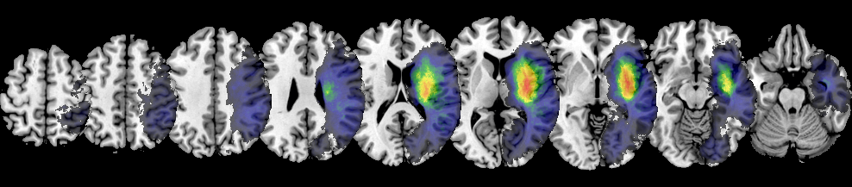
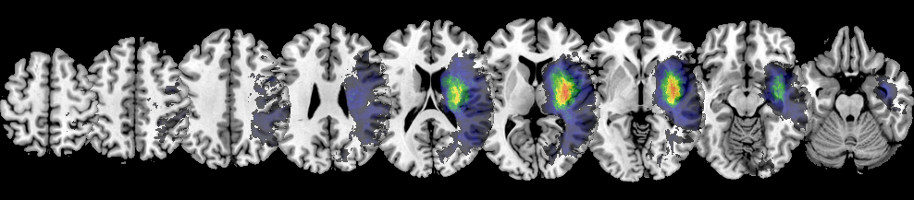
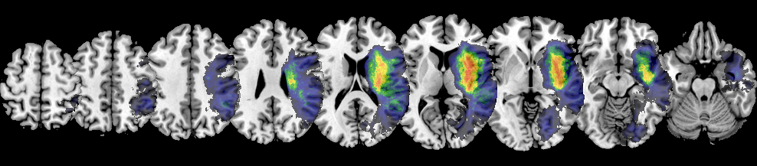
ALL
A L L P A T I E N T S
FEMALE
MALE

Slide 4
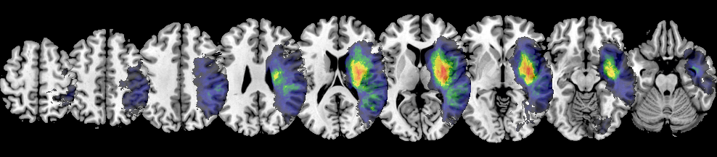
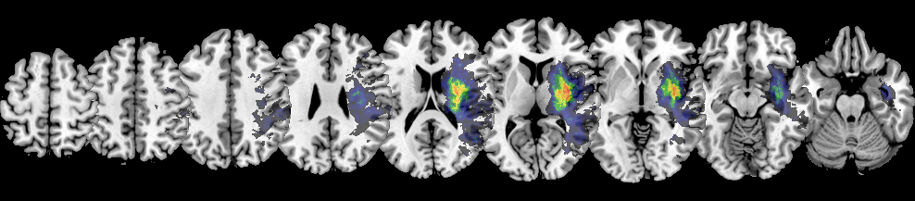
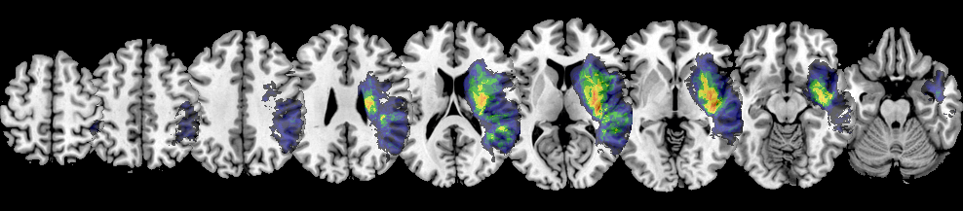
ALL
N E G L E C T
FEMALE
MALE

Slide 5
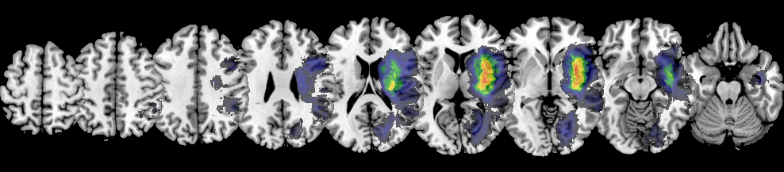
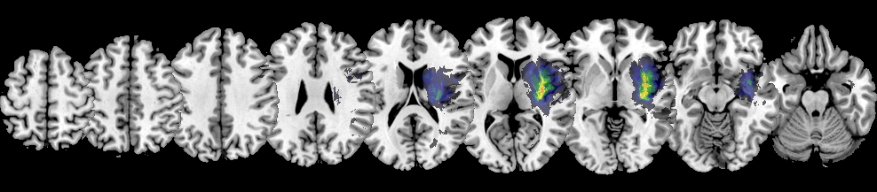
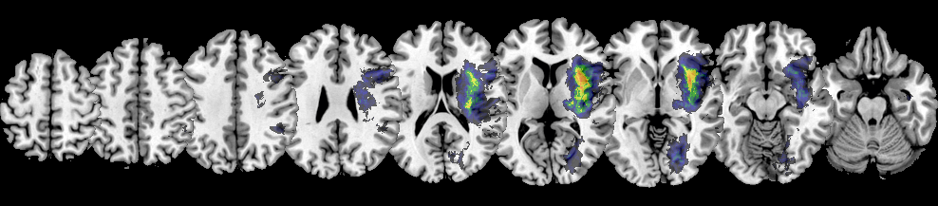
ALL
C O N T R O L
FEMALE
MALE

Slide 6
Lesion Subtraction Plots
Created with MRIcron

Slide 7
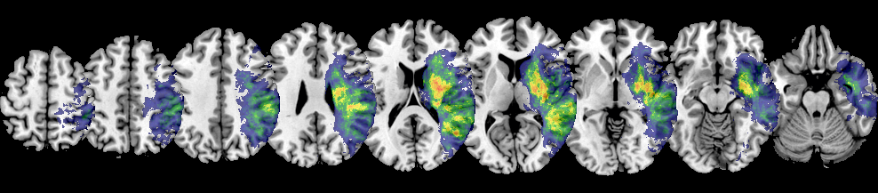
A L L P A T I E N T S
All Neglect – All Control

Slide 8
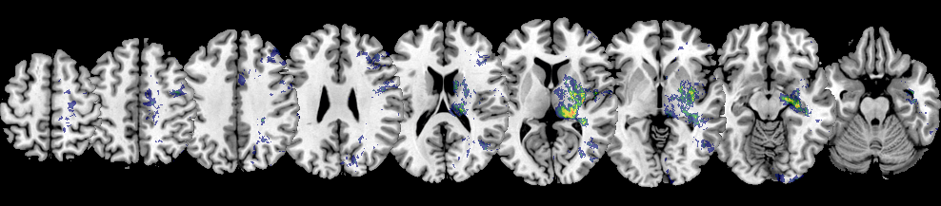
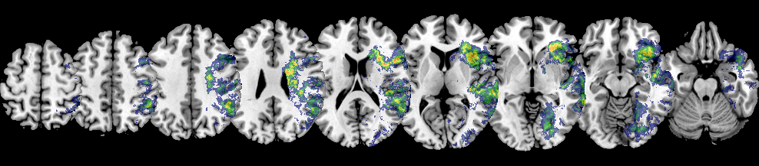
A L L P A T I E N T S
All Female – All Male
All Male – All Female

Slide 9
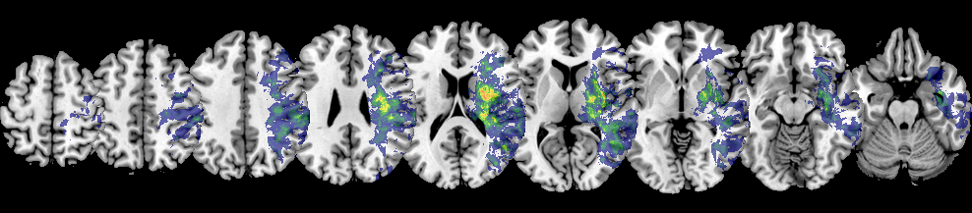
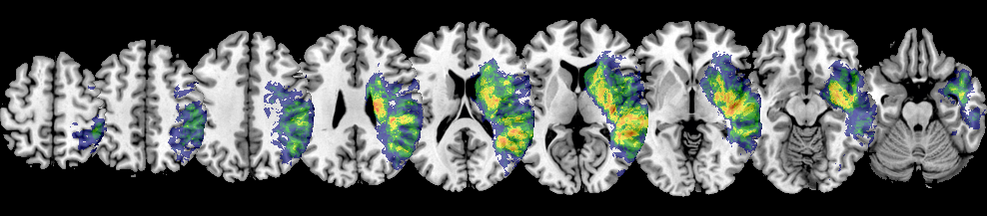
N E G L E C T
Neglect Female – Control Female
Neglect Male – Control Male

Slide 10
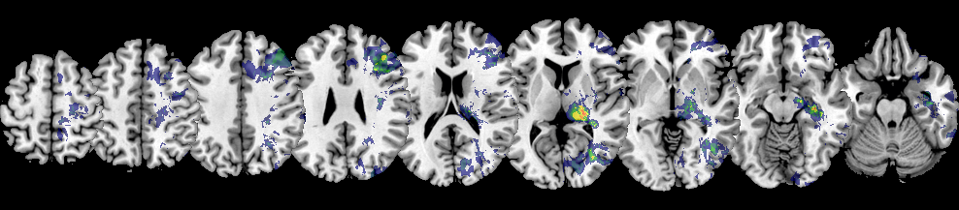
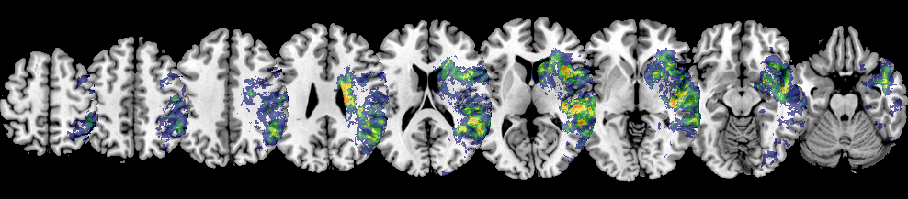
Neglect Female – Neglect Male
N E G L E C T
Neglect Male – Neglect Female

Slide 11
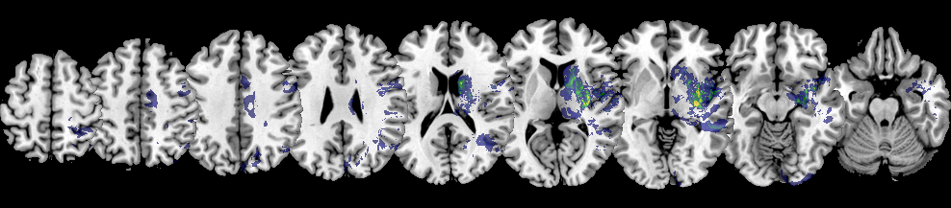
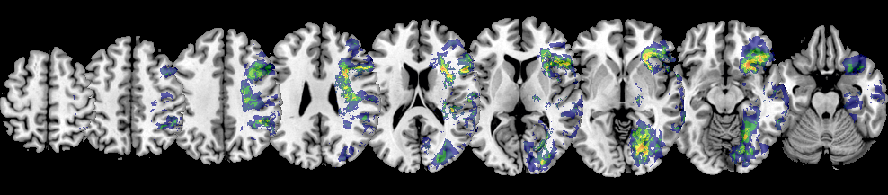
Control Female – Control Male
C O N T R O L
Control Male – Control Female

Slide 12
Univariate VLBM – Lesion Maps
Created with NiiStat
Plotted with MRIcron

Slide 13
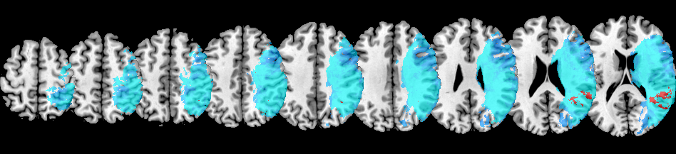
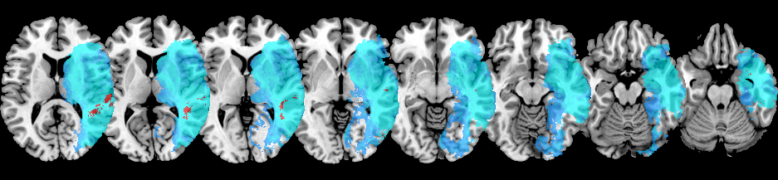
A L L P A T I E N T S
blue = included voxels | red = significant voxels (n = 4232)

Slide 14
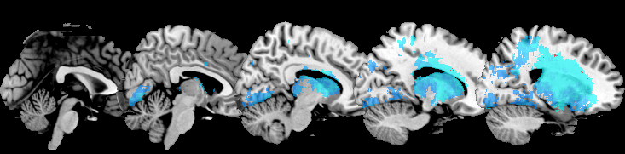
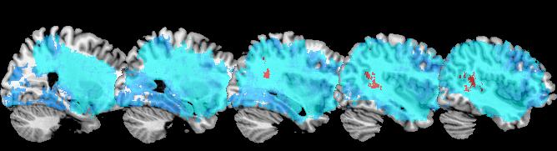
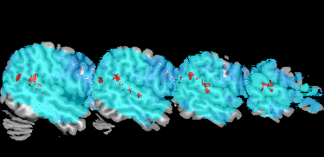
A L L P A T I E N T S
blue = included voxels | red = significant voxels (n = 4232)

Slide 15
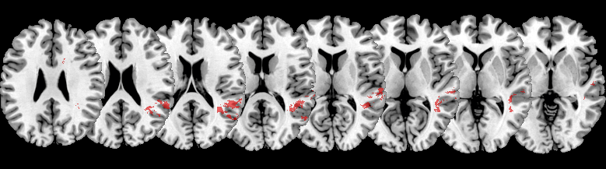
A L L P A T I E N T S
red = significant voxels (n = 4232)

Slide 16
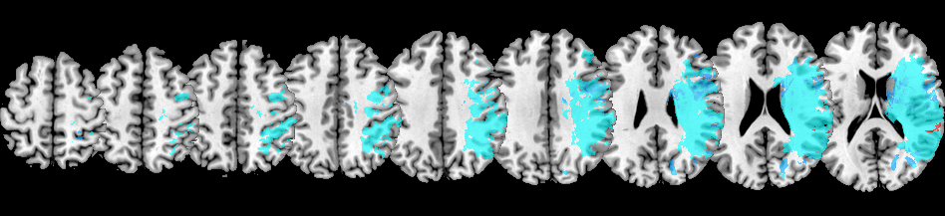
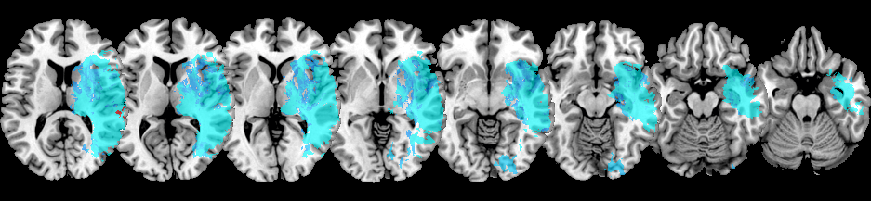
F E M A L E
blue = included voxels | red = significant voxels (n = 323)

Slide 17
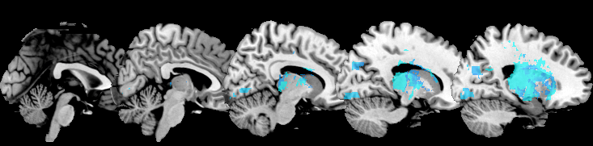
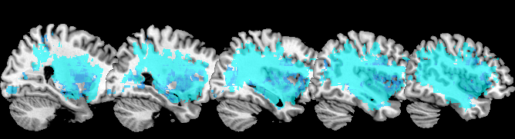
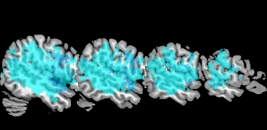
F E M A L E
blue = included voxels | red = significant voxels (n = 323)

Slide 18
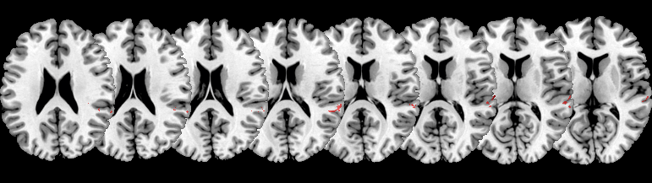
F E M A L E
red = significant voxels (n = 323)

Slide 19
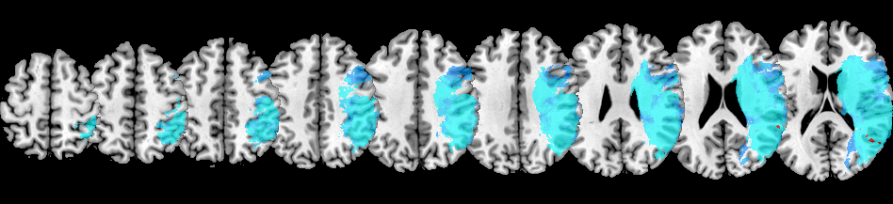
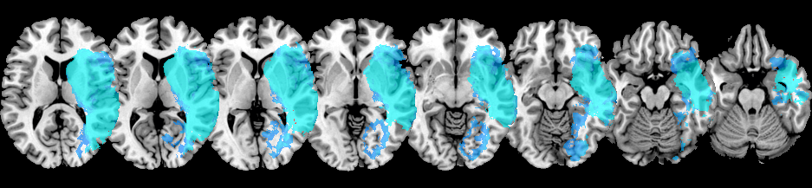
M A L E
blue = included voxels | red = significant voxels (n = 273)

Slide 20
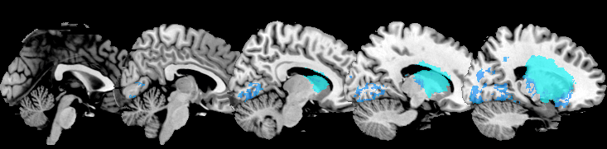
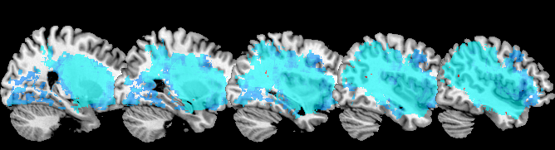
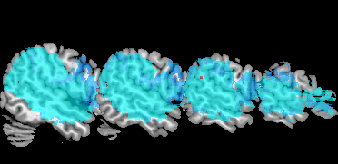
M A L E
blue = included voxels | red = significant voxels (n = 273)

Slide 21
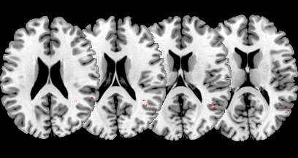
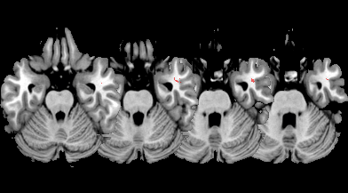
M A L E
red = significant voxels (n = 273)

Slide 22
Disconnection Plots
Created with MRIcron

Slide 23
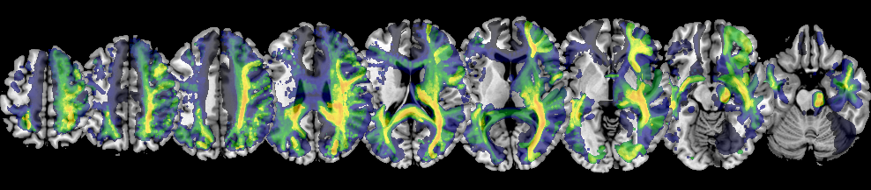
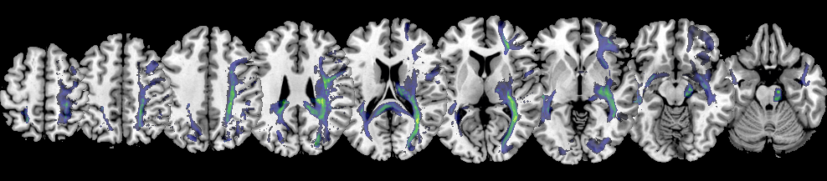
A L L P A T I E N T S
Overlap Disconnection
Overlap Disconnection (≥50%)

Slide 24
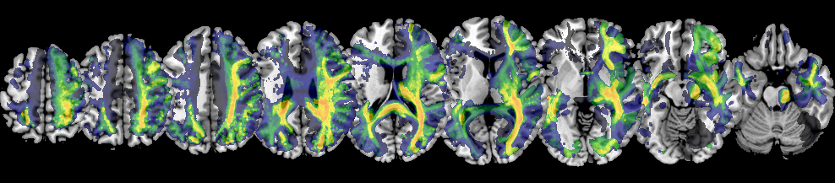
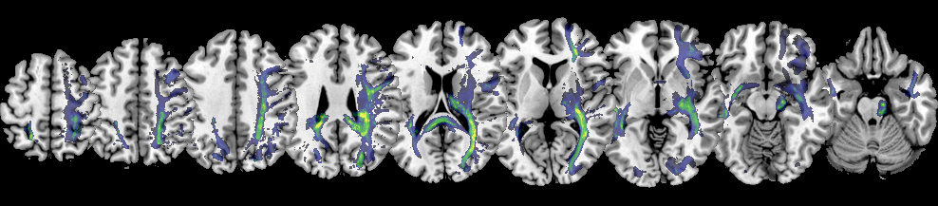
Overlap Disconnection
F E M A L E
Overlap Disconnection (≥50%)

Slide 25
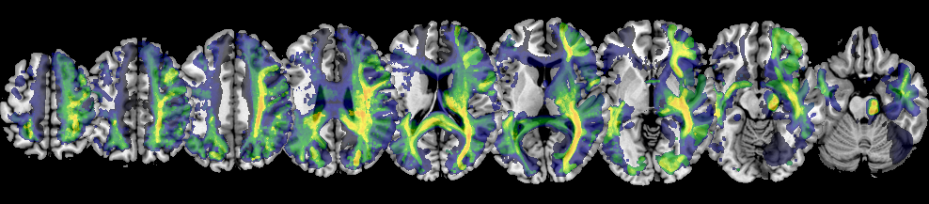
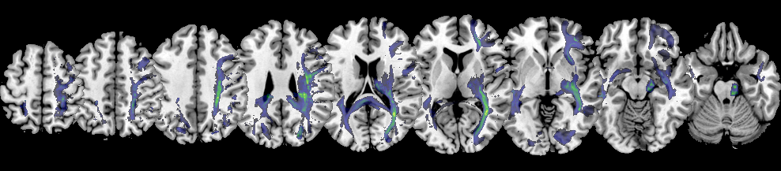
Overlap Disconnection
M A L E
Overlap Disconnection (≥50%)

Slide 26
ALL
FEMALE
MALE

Slide 27
ALL
FEMALE
MALE

Slide 28
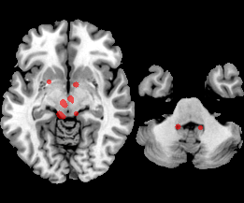

Slide 29
Subtraction Plots of Whole-brain Disconnectivity
Created with MRIcron

Slide 30
Disconnection Plots
Created with Matlab

Slide 31
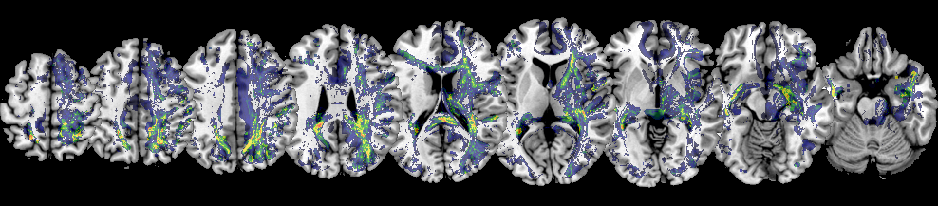
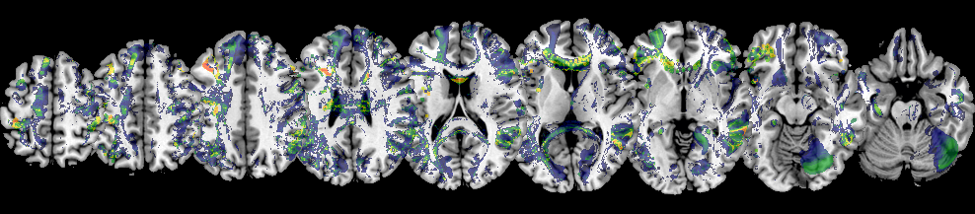

Slide 32
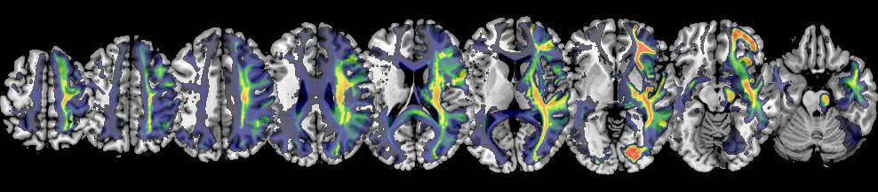
A L L P A T I E N T S
Average Disconnection

Slide 33
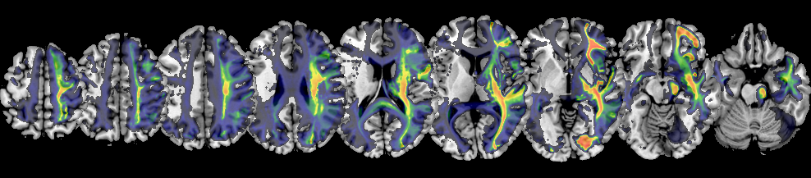
F E M A L E
Average Disconnection

Slide 34
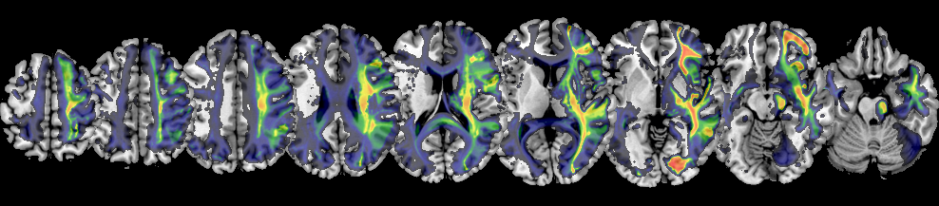
M A L E
Average Disconnection

Slide 35
ALL
FEMALE
MALE

Slide 36
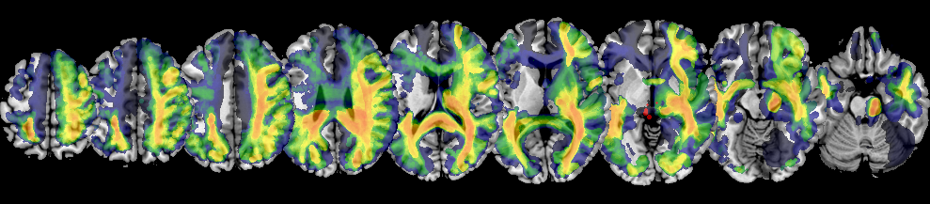

A L L P A T I E N T S
Overlap Disconnection
Overlap Disconnection (≥50%)

Slide 37


Overlap Disconnection
F E M A L E
Overlap Disconnection (≥50%)

Slide 38


Overlap Disconnection
M A L E
Overlap Disconnection (≥50%)

Slide 39
ALL
FEMALE
MALE

Slide 40
ALL
FEMALE
MALE

Slide 41
Univariate VLBM – Disconnection Maps
.
Created with NiiStat

Slide 42


No Voxels Survived
All Patients
Female Patients
Male Patients

Slide 43
ROI-to-ROI Disconnections
Created with Matlab

Slide 44








Nr. of significant disconnections at different p-levels
p = 0.05 -> 893
p = 0.01 -> 760
p = 0.005 -> 687
p = 0.001 -> 501
A L L P A T I E N T S
p = 0.0005 -> 446
p = 0.0001 -> 251
p = 0.00005 -> 153
p = 0.00001 -> 95
FWER corrected | Patient Threshold = 45

Slide 45








Nr. of significant disconnections at different p-levels
p = 0.05 -> 893
p = 0.01 -> 760
p = 0.005 -> 687
p = 0.001 -> 501
A L L P A T I E N T S
p = 0.0005 -> 446
p = 0.0001 -> 251
p = 0.00005 -> 153
p = 0.00001 -> 95
FWER corrected | Patient Threshold = 45

Slide 46








Nr. of significant disconnections at different p-levels
p = 0.05 -> 893
p = 0.01 -> 760
p = 0.005 -> 687
p = 0.001 -> 501
A L L P A T I E N T S
p = 0.0005 -> 446
p = 0.0001 -> 251
p = 0.00005 -> 153
p = 0.00001 -> 95
FWER corrected | Patient Threshold = 45

Slide 47



Nr. of significant disconnections at different p-levels
p = 0.05 -> 205
p = 0.01 -> 7
p = 0.005 -> 2
F E M A L E
FWER corrected | Patient Threshold = 20

Slide 48



Nr. of significant disconnections at different p-levels
p = 0.05 -> 205
p = 0.01 -> 7
p = 0.005 -> 2
F E M A L E
FWER corrected | Patient Threshold = 20

Slide 49



Nr. of significant disconnections at different p-levels
p = 0.05 -> 205
p = 0.01 -> 7
p = 0.005 -> 2
F E M A L E
FWER corrected | Patient Threshold = 20

Slide 50







Nr. of significant disconnections at different p-levels
p = 0.05 -> 611
p = 0.01 -> 349
p = 0.005 -> 249
p = 0.001 -> 64
M A L E
p = 0.0005 -> 30
p = 0.0001 -> 5
p = 0.00005 -> 2
FWER corrected | Patient Threshold = 20

Slide 51







Nr. of significant disconnections at different p-levels
p = 0.05 -> 611
p = 0.01 -> 349
p = 0.005 -> 249
p = 0.001 -> 64
M A L E
p = 0.0005 -> 30
p = 0.0001 -> 5
p = 0.00005 -> 2
FWER corrected | Patient Threshold = 20

Slide 52







Nr. of significant disconnections at different p-levels
p = 0.05 -> 611
p = 0.01 -> 349
p = 0.005 -> 249
p = 0.001 -> 64
M A L E
p = 0.0005 -> 30
p = 0.0001 -> 5
p = 0.00005 -> 2
FWER corrected | Patient Threshold = 20

Slide 53
Ratio of Interhemispheric/Intrahemispheric Disconnections
 | p = 0.05 | p = 0.01 | p = 0.005
All | 607/286 (68%) | 541/219 (71.2%) | 489/198 (71.1%)
Female | 145/60 (70.7%) | 7/7 (50%) | 2/2 (50%)
Male | 428/183 (70%) | 269/80 (77%) | 201/48 (80.7%)
#Inter/#Intra (% Inter)

Slide 54
Node/ROI with the most significant disconnections
 | p = 0.05 | p = 0.01 | p = 0.005
All | IPL(144) → 48 | IPL(144) → 46 | IPL(144) → 144
Female | pSTS(124) → 38 | THA(242) → 3 | THA(242) → 2
Male | IPL(144) → 42 | ITG(98) → 38 | ITG(98) → 33

Slide 55
Top 10 most significant disconnections (highest t statistics)
All | Female | Male
MTG-ITG (inter) | ITG-THA (intra) | ITG-ITG (inter)
MTG-ITG (inter) | SPL-THA (intra) | MTG-ITG (inter)
STG-ITG (inter) | SPL-THA (intra) | ITG-IPL (inter)
ITG-IPL (inter) | IPL-THA (intra) | ITG-IPL (inter)
ITG-IPL (inter) | IPL-THA (intra) | ITG-pSTS (inter)
STG-ITG (inter) | IPL-THA (intra) | MTG-ITG (inter)
ITG-IPL (inter) | SPL-THA (intra) | STG-ITG (inter)
MTG-ITG (inter) | ITG-IPL (inter) | ITG-IPL (inter)
ITG-ITG (inter) | ITG-ITG (inter) | MTG-ITG (inter)
ITG-IPL (inter) | IPL-THA (intra) | ITG-IPL (inter)

Slide 56
Nr. of significantly disconnected nodes per „Lobe“/ROI at p = 0.05
 | All (n = 1786) | Female (n = 410) | Male (n = 1222)
Amygdala | 12 (0.7%) | / | 7 (0.6%)
BG | 60 (3.4%) | 2 (0.5%) | 37 (3.0%)
Frontal | 112 (6.3%) | 7 (1.7%) | 84 (6.9%)
Hippocampus | 27 (1.5%) | 3 (0.7%) | 13 (1.1%)
Insula | 8 (0.4%) | / | 9 (0.7%)
Occipital | 108 (6.0%) | 9 (2.2%) | 92 (7.5%)
Parietal | 554 (30.5%) | 101 (24.6%) | 324 (26.5%)
Temporal | 750 (42.0%) | 237 (57.8%) | 595 (48.7%)
Thalamus | 155 (8.7%) | 51 (12.4%) | 61 (5.0%)

Slide 57
ROI-to-ROI Disconnections
Created with R & Bayesian Statistics

Slide 58



Significant Disconnections (BF > log(3))
All Female Male

Slide 59
Correlation: SSPLs/Behaviour
Created with Matlab

Slide 60

Sign. Correlation between SSPL increase & Behaviour
X
Delta SSPL
Indirect SSPL
X

Slide 61
Bayesian Correlation: SSPLs/Behaviour
Created with R

Slide 62


Sign. Correlation between SSPL increase & Behaviour
Delta SSPL
Indirect SSPL
A L L P A T I E N T S

Slide 63
Sign. Correlation between SSPL increase & Behaviour
X
Delta SSPL
Indirect SSPL
X
F E M A L E

Slide 64

Sign. Correlation between SSPL increase & Behaviour
Delta SSPL
Indirect SSPL
M A L E
→ Higher BFs than for “all“

Slide 65

Sign. Correlation between SSPL increase & Behaviour
Delta SSPL
A L L P A T I E N T S
→ Higher BFs than for “all“

Slide 66




p = 0.05 -> 537
p = 0.01 -> 113
A L L P A T I E N T S
p = 0.005 -> 64
p = 0.001 -> 5

Slide 67




p = 0.05 -> 537
p = 0.01 -> 113
A L L P A T I E N T S
p = 0.005 -> 64
p = 0.001 -> 5

Slide 68




p = 0.05 -> 265
p = 0.01 -> 52
F E M A L E
p = 0.005 -> 25
p = 0.001 -> 6

Slide 69




p = 0.05 -> 265
p = 0.01 -> 52
F E M A L E
p = 0.005 -> 25
p = 0.001 -> 6

Slide 70




p = 0.05 -> 49
p = 0.01 -> 16
M A L E
p = 0.005 -> 13
p = 0.001 -> 1

Slide 71




p = 0.05 -> 49
p = 0.01 -> 16
M A L E
p = 0.005 -> 13
p = 0.001 -> 1

Slide 72
Ratio of Interhemispheric/Intrahemispheric Increase in SSPLs
 | p = 0.05 | p = 0.01 | p = 0.005 | p = 0.001
All | 259/278 (48%) | 49/64 (43%) | 25/39 (39%) | 3/2 (60%)
Female | 119/146 (44%) | 27/25 (52%) | 10/15 (40%) | 1/5 (17%)
Male | 18/31 (36%) | 6/10 (38%) | 5/8 (38%) | 0/1 (0%)
#Inter/#Intra (% Inter)

Slide 73
Node/ROI involved in most significant SSPL Increases
 | p = 0.05 | p = 0.01 | p = 0.005 | p = 0.001
All | INS(172) → 77 | INS(172) → 16 | INS(172) → 11 | ITG(98) → 2
Female | INS(168) → 33 | BG(224) → 10 | INS(168) → 3 | MFG(20) → 1
Male | PhG(112) → 9 | MVOcC(192) → 6 | MVOcC(192) → 6 | PrG(60) → 1
#Inter/#Intra (% Inter)

Slide 74
Top 10 most significant SSPL increases (highest p values)
All | Female | Male
MFG-ITG (inter) | MFG-pSTS (inter) | PrG-MVOcC (intra)
IPL-INS (intra) | INS-MVOcC (intra) | IFG-MVOcC (intra)
SFG-ITG (inter) | IPL-INS (intra) | MFG-MVOcC (intra)
SFG-ITG (inter) | PhG-BG (intra) | STG-PhG (inter)
LOcC-BG (intra) | PrG-PhG (intra) | LOcC-THA (intra)
OrG-MVOcC (inter) | IFG-AMYG (intra) | STG-MVOcC (inter)
IFG-pSTS (intra) | LOcC-THA (intra) | pSTS-MVOcC (inter)
MFG-IFG (inter) | PoG-MVOcC (intra) | STG-MVOcC (inter)
INS-THA (inter) | OrG-INS (inter) | pSTS-MVOcC (inter)
OrG-STG (inter) | OrG-INS (inter) | IFG-FuG (intra)

Slide 75
% of significant SSPL increases per „Lobe“/ROI at p = 0.05
 | All | Female | Male
Amygdala | 0.7% | 2% | --
BG | 7% | 14% | 1%
Frontal | 23% | 23% | 21%
Hippocampus | 1% | 3% | --
Insula | 20% | 11% | 1%
Limbic | 3% | 4% | --
Occipital | 6% | 12% | 33%
Parietal | 11% | 9% | 9%
Temporal | 23% | 15% | 32%
Thalamus | 4% | 7% | 3%

